Slide 1

Lab

Slide 2
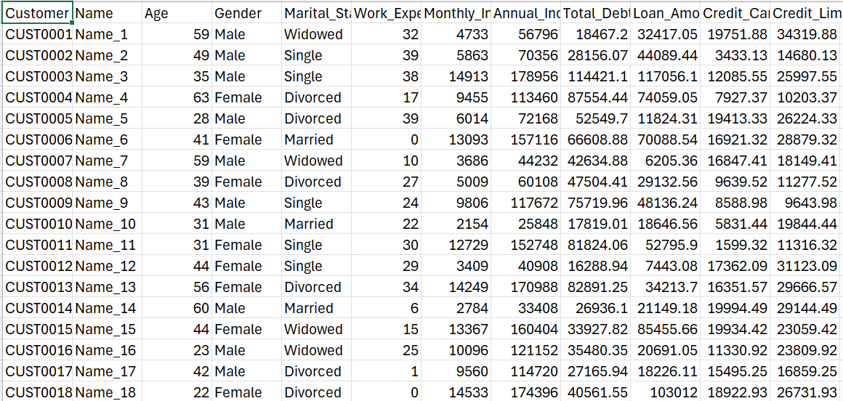

Slide 3
Tasks
1. Data Loading and
2. Create the target variable: True if Credit_Limit > 20000, else False
3. Data Preparation for Modeling
Perform encoding of 'Gender', 'Marital_Status’ using Pandas pd.get_dummies
4. Feature Selection using Correlation Matrix
5. Feature Selection using PCA
6. Perform classification using

